Slide 1

Beam-forming in Visible Light Communication For Multiple Users
M.N.K.M Bandara
S.M.S.M Bandara
Faculty of Engineering
Dept of ENTC

Slide 2
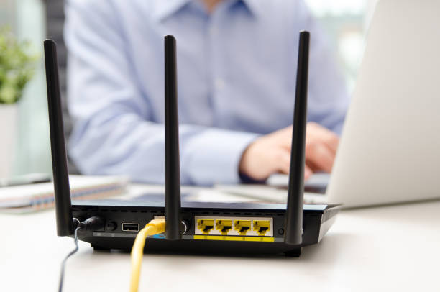
The Problem to be Solved
Indoor wireless communication faces challenges like limited coverage, interference, and scalability.
Visible Light Communication (VLC) offers a solution but has limitations.
Our project aims to address these limitations through VLC with beamforming.

Slide 3
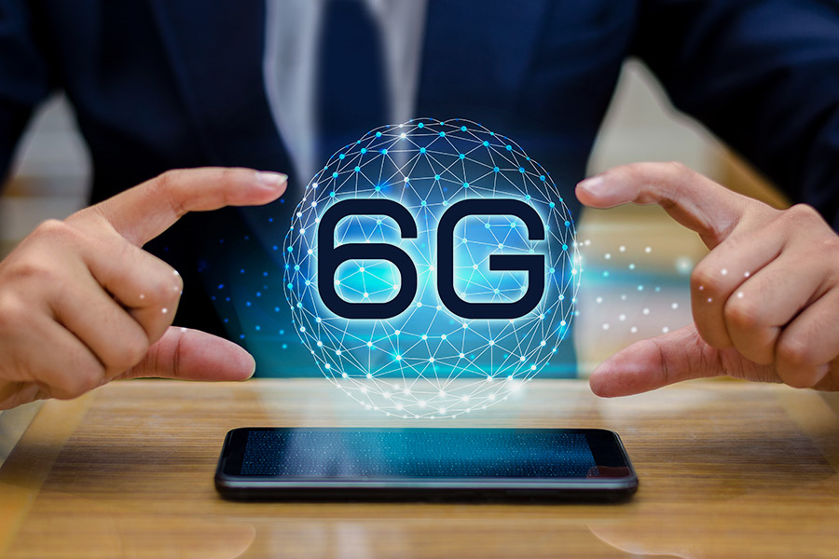
Alternative Methods Have Been Studied
Conducted a thorough literature review on VLC and beamforming techniques.
Explored existing research on hardware and software solutions for indoor wireless communication.
Identified gaps and opportunities for innovation in VLC system design.

Slide 4

Selected Methods
Photodiodes offer sensitivity to detect modulated light signals transmitted by LEDs.
LEDs provide a reliable means of transmitting data wirelessly in indoor environments.
Combined use of photodiodes and LEDs offers a cost-effective and efficient solution for VLC with beamforming.

Slide 5
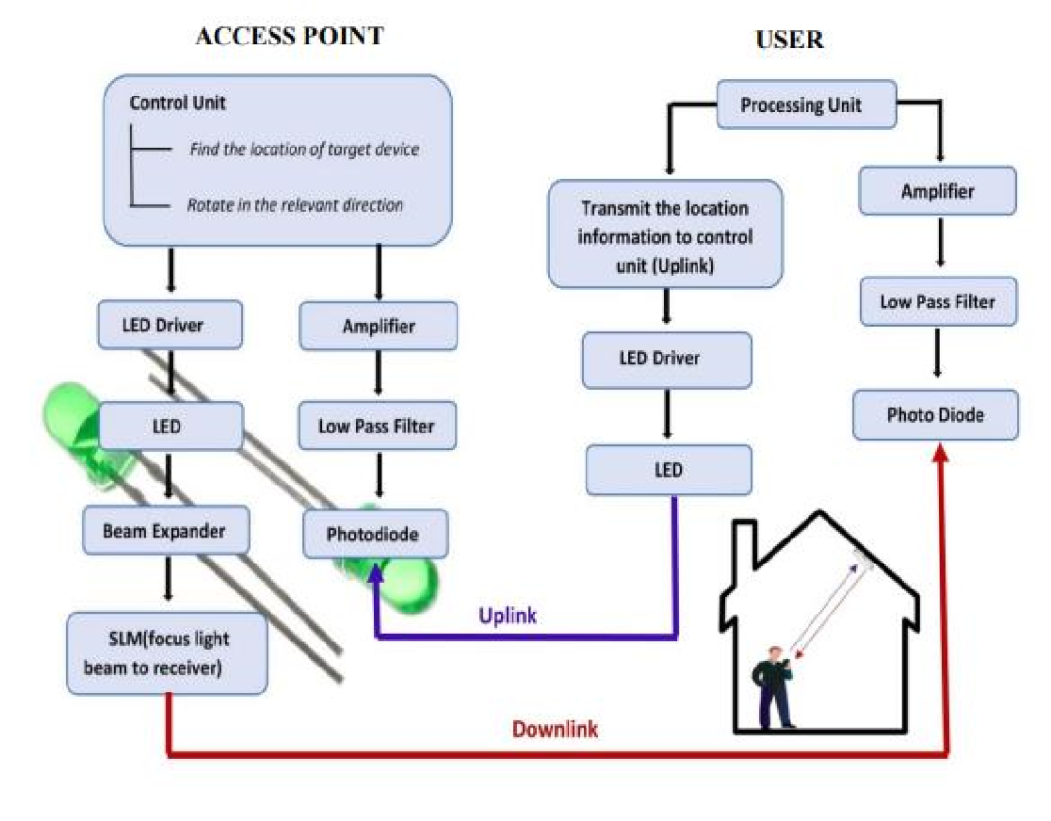

Slide 6
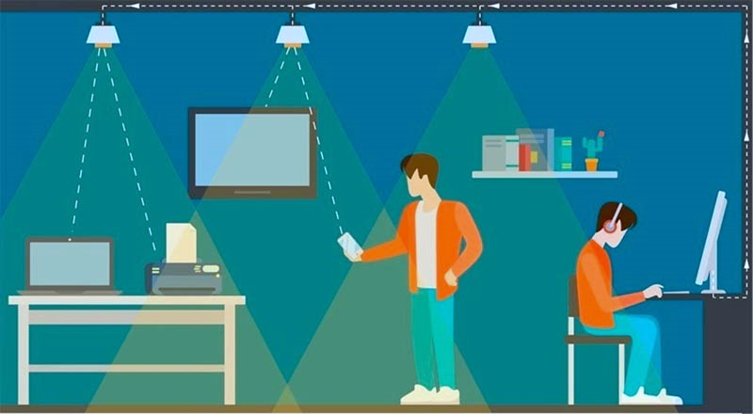
The Basic Architecture of the Project
Transmitter: LED array with individually controllable light intensity.
Receiver: Photodiode for capturing transmitted light signals.
Beamforming algorithms: Dynamically adjust LED array for optimal transmission detected by photodiodes.

Slide 7

Possible Risk Factors/Obstacles
Complexity of hardware and software integration for photodiodes and LEDs.
Calibration and alignment challenges for LED array and photodiode.
Interference from ambient light sources affecting photodiode reception in VLC system.

Slide 8

Thank You

